Slide 1
King’s Park Secondary School
Equality and Diversity Day! 8th December 2017

Slide 2
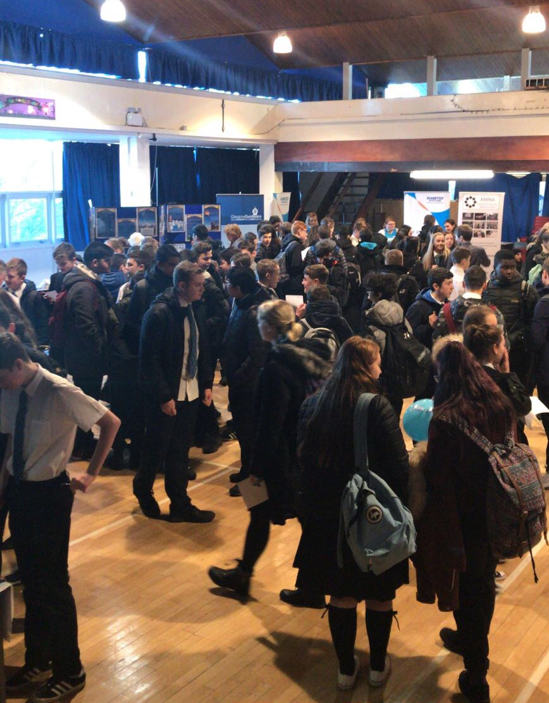
What did we do?
We all participated in an event which represented our diverse school community.

Slide 3
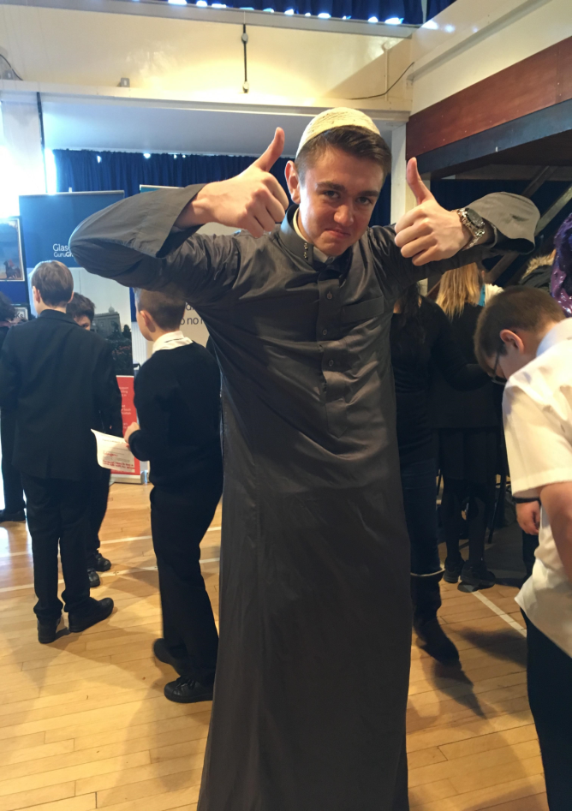
Who did we meet?
Sikh Gurdwada
LGBT Youth Scotland
AMINA Women's Muslim Group
Glasgow Disability Alliance
Youth Community Service

Slide 4
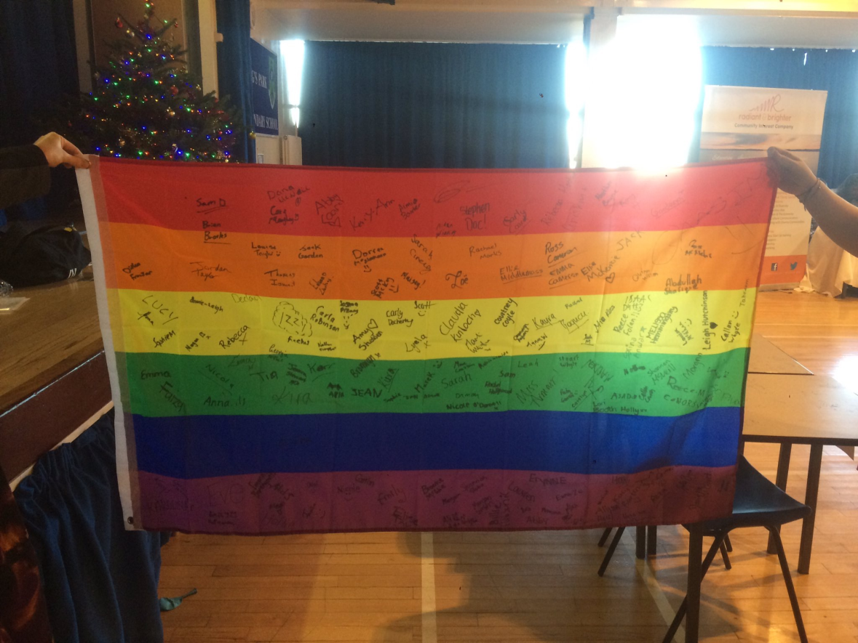

Slide 5
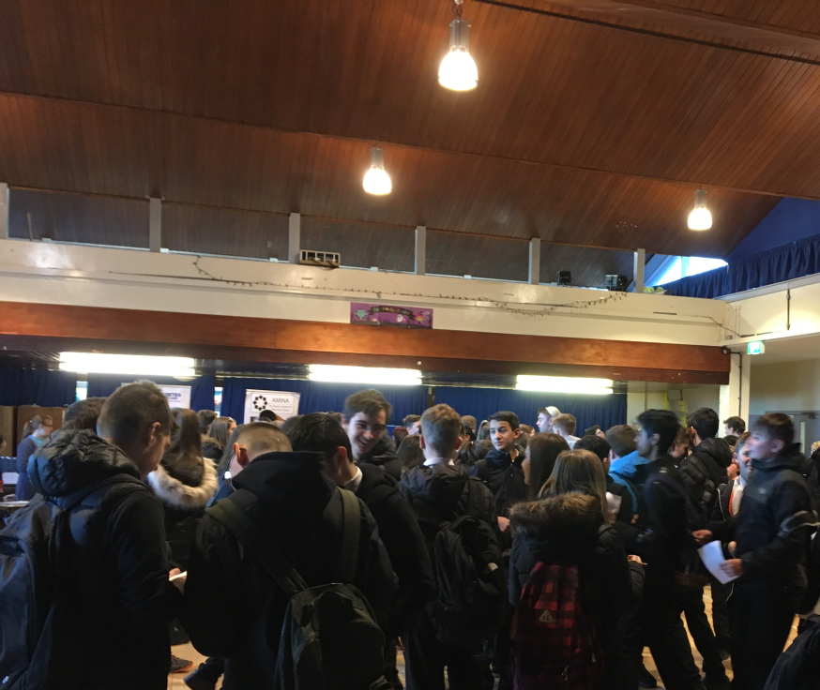
Who did we meet?
Diabetes Scotland
Humanist Society Scotland
Chaplaincy Team
Radiant and Bright
Scottish Youth Parliament

Slide 6
Why did we do this?
We are all different and this is a fantastic thing!
We live and work together it is important to learn about each others cultures and beliefs!
We are part of a bigger community and it is important to be a responsible member of the community.
We have a responsibility to challenge prejudice and discrimination wherever it occurs!

Slide 7
King’s Park Secondary School
Our school aims to be a safe & inspiring place to learn, where children's rights are respected, their talents are nurtured & they are able to thrive.
Working towards our Rights Respecting School Charter.

