Slide 1
PUPIL Support (Pastoral Care) in King’s Park Secondary

Slide 2
Moving to King’s Park Secondary
Moving to Secondary can be a great experience for the pupils. A lot of preparation work has taken place to ensure that we fully support pupils throughout their transition.
Pupil Support staff have been to our cluster primaries and contacted all others to receive useful information about how we can support your child in their transition.
Staff from across the school have worked with pupils throughout this year.
The pupils receive two Transition Day visits.

Slide 3
What is Pastoral Care?
Pastoral Care are here if you have any concerns regarding your child. Please contact the school office and ask to speak to your child’s Pastoral Care teacher.

Slide 4
What will a typical day at King’s Park Secondary be like?

Slide 5
The School Day
 | Monday- Wednesday | Thursday- Friday
Period 1 | 8.50-9.40 | 8.50-9.40
Period 2 | 9.40-10.30 | 9.40-10.30
Period 3 | 10.45-11.35 | 10.45-11.35
Period 4 | 11.35-12.25 | 11.35-12.25
Period 5 | 1.05-1.55 | 1.05-1.55
Period 6 | 1.55-2.45 | 1.55-2.45
Period 7 | 2.45-3.35

Slide 6
Timetable

Slide 7
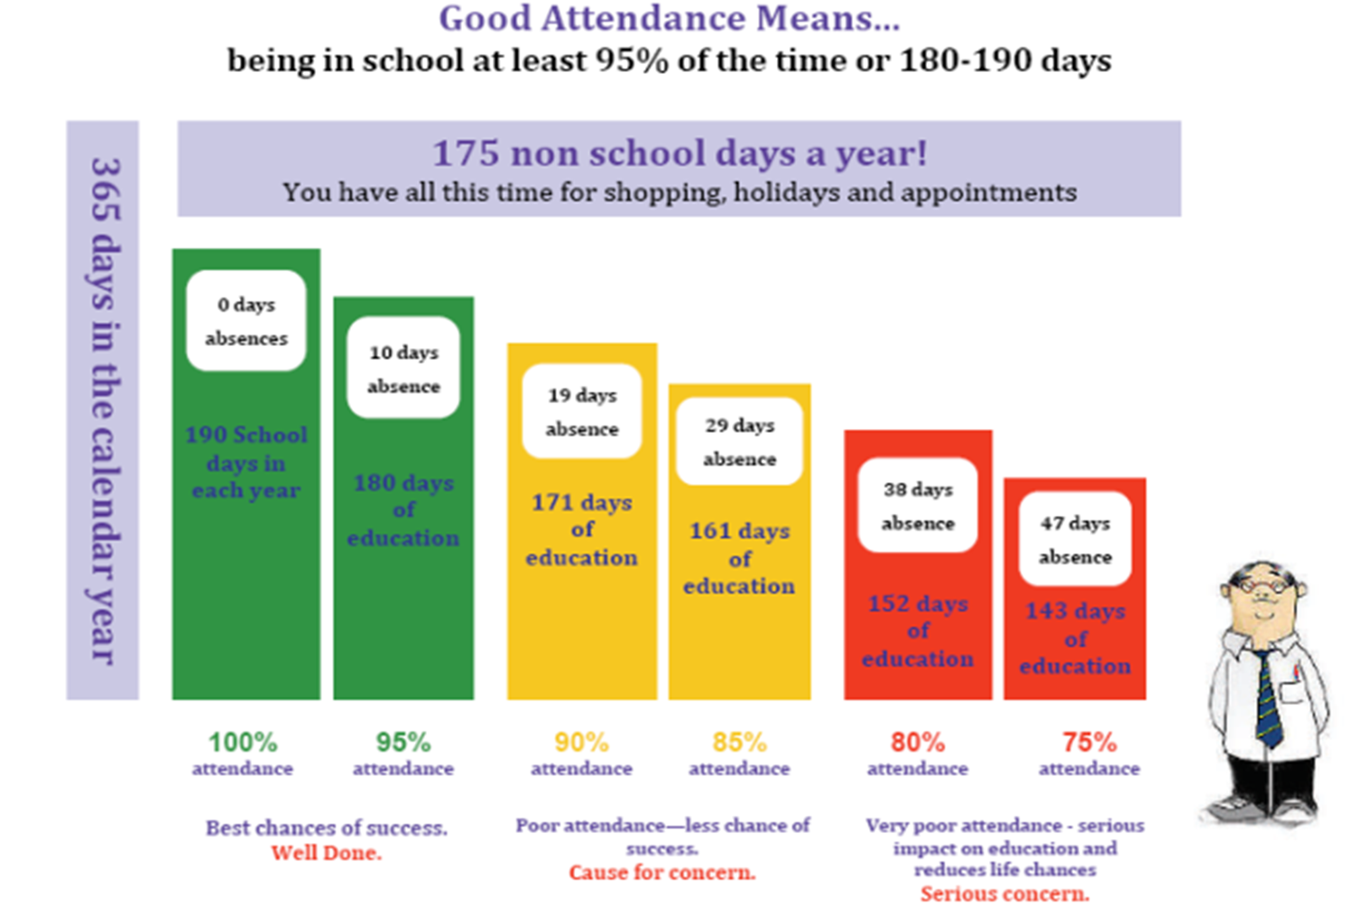
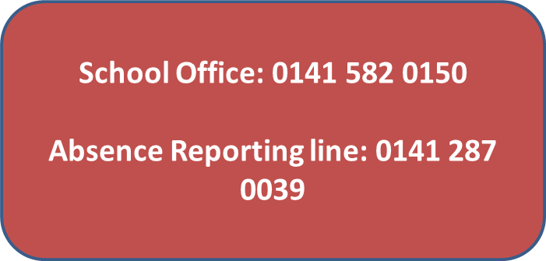
Attendance
Attendance is very important in allowing pupils to succeed and also to fully involve themselves in the school.
Attendance procedures
Any time a pupil is off a phone call or note must explain why the pupil was off.
Any appointments in school time should be reported in advance.
Please advise us of any number changes during the year to allow us to contact you if needed

Slide 8
Absence reporting
If you child is unwell and will not attend school, please contact the Absence Reporting Line on 0141 287 0039.
A note should be brought into school when the pupil returns.
If you are aware in advance of a future absence, please send a note with your child to Pastoral Care. This helps us to update the registers accordingly and will prevent an absence text being sent out in error.

Slide 9
Uniform
School Tie
White shirt or blouse
Black skirt (knee length) or black trousers.
Black sweater
Black Blazer
Plain Black shoes or boots
Further Support:
For families who need further support with purchasing uniform, it is possible to apply for a clothing grant. Forms can be picked up from the school office.

Slide 10
How can pupils get involved?
 | Before school | Lunchtime | After school
Monday | Breakfast Club – room 405 | Badminton – Middle Gym Anime Club – room 101 Creative Writing Club – room 110 Open house – games / chat / homework – room 405 | Basketball – Middle Gym Dance – Gym 1 (left) S1 / S2 Football - outside
Tuesday | Breakfast Club – room 405 | Table Tennis – Gym 2 (right) Basketball – Middle Gym Football – outside Amnesty International – room 113 S1/ S2 Music Club – Music Department Open house – games / chat / homework – room 405 | Gymnastics – Gym 1 (left) Rugby - outside School Show Choir – Music Department
Wednesday | Breakfast Club – room 405 | Conversation Café – Mental Health Awareness – Nurture Room Dance – Gym 1 (left) Film Club – room 111 Ceilidh Band – Music Department Open house – games / chat / homework – room 405 | Boxing – Gym 2 (right) Running Club – outside Orchestra – Assembly Hall
Thursday | Breakfast Club – room 405 | Football – outside Amnesty International – room 113 Ukulele Club – Music Department Stem Club – Lab 3 Open house – games / chat / homework – room 405 | Girls’ football – outside S1/S2 Drama Club – Drama Department
Friday | Breakfast Club – room 405 | Conversation Café - LGBT & friends – room 204 Science Club – Lab 1 Open house – games / chat / homework – room 405 | Art, Design and Photography – senior supported study – Art Department

Slide 11
Lunch time
Lunches in school provide a healthy choice for pupils.
There are Halal and Vegetarian options available.
Pupils can pay for lunches with a Q-card; this is also the way in which free school meals are paid for.
If you think your child is due a free school meal, apply for this and send the form to the school office.

Slide 12
Useful Contacts
Telephone number: 0141 582 0150
Twitter: KPSS@KingsParkSec
(All departments have their own twitter page and share lots of information both pupils and parents/carers might find useful.)
Website: www.kingspark-sec.glasgow.sch.uk

