Slide 1
S2 Personalisation and Choice
January 2024

Slide 2
S2 Personalisation and Choice
Next year you will have the opportunity to personalise your curriculum in certain areas.
In S3, all pupils will continue studies in the following subjects:
English
Maths
Health and Wellbeing
PE
RME
PSE

Slide 3
Topics
Skills
Drama
Poetry
Novels
Short Stories
Journalism & Persuasive Writing
Film & Media
Creative & Personal Writing
Understanding skills (own words questions, summarising, identifying)
Analysing language, characters & much more
Evaluating how well writer’s write
Creating imaginative and fun pieces of work
Applying knowledge and skills
Researching
Listening and watching for information

Slide 4
Mathematics
Research the impact of maths on the real world
Bias & misleading statistics in
the media
Analysis of real life data & mathematical modelling.

Slide 5
S3 Health and Wellbeing
All young people will continue to receive Health and Wellbeing in S3. The reason for this is simple: there is nothing more important than Health and Wellbeing in order for you to achieve your full potential in school. As a school we care deeply about your mental, physical, social and emotional wellbeing. As a result PE and PSE will both be part of your timetable.
PE will be delighted to let you pick our subjects at certificated levels in S4, S5 and S6.

Slide 6
S2 Personalisation and Choice
In addition to these core subjects you will choose:
1 Expressive Arts subject;
1 Modern Language;
1 Science subject;
1 Humanities subject (Social Subjects);
1 Technology subject;
1 additional subject from any curricular
area, German as a 2nd language or Design and
Manufacture.

Slide 7
Let’s have a closer look at each choice you need to make

Slide 8
Expressive Arts
You are choosing (at least) one of the following subjects:
Art and Design
Dance
Drama
Music

Slide 9
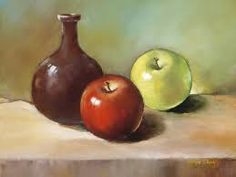
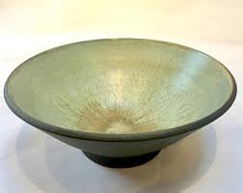
Art and Design
Research, design, create and review – ceramic fruit bowl
Product
Design
Unit
Expressive
Unit
Research paintings, then design and create a still life image
Notes:
All pupils follow a product design unit observing examples of excellent products in society. All pupils then begin work on a research and development project on ceramic fruit bowl design. They will look at a variety of themes and established products and develop a personal design from their initial selection.
All pupils will create a ceramic bowl in S3 using a clay coil method. This will be glazed and fired and will be available for the pupils to take home.
All pupils will critically review a variety of product design and will research the work of selected designers.
Expressive
All pupils follow an expressive unit observing examples of excellent paintings in society. All pupils then begin work on a research and development project on a still life image. They will look at a variety of themes and established paintings and develop a personal theme from their initial selection.
All pupils will create an A2 or A3 expressive painting / chalk pastel / oil pastel outcome.
All pupils will critically review a variety of paintings and will research the work of selected expressive artists

Slide 10
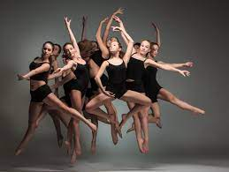
Dance
During this course you will:
Develop your confidence
Develop your coordination and timing
Develop your creativity skills
Learn about different style of dance (e.g. Contemporary, Hip-Hop, Charleston, Bollywood and many more.
Perform solo and group dances
Learn how to create your own choreography
Notes:
All pupils follow a product design unit observing examples of excellent products in society. All pupils then begin work on a research and development project on ceramic fruit bowl design. They will look at a variety of themes and established products and develop a personal design from their initial selection.
All pupils will create a ceramic bowl in S3 using a clay coil method. This will be glazed and fired and will be available for the pupils to take home.
All pupils will critically review a variety of product design and will research the work of selected designers.
Expressive
All pupils follow an expressive unit observing examples of excellent paintings in society. All pupils then begin work on a research and development project on a still life image. They will look at a variety of themes and established paintings and develop a personal theme from their initial selection.
All pupils will create an A2 or A3 expressive painting / chalk pastel / oil pastel outcome.
All pupils will critically review a variety of paintings and will research the work of selected expressive artists

Slide 11
Drama
Devising Drama
Peer Assessment
Practical Work
Teamwork
Make up & Costumes
Drama Terminology
Film and sound editing
Performing opportunities
Lighting and sound

Slide 12
Music
Learn about different genres of music (e.g. Popular, Classical and Scottish)
Choose two instruments:
Voice
Tuned Percussion Keyboard
Guitar
Bass Guitar
Drum kit
Orchestral
Learn how to read music
Create/ Compose your own pieces
Perform your pieces to the class
Tests - Practical and written

Slide 13
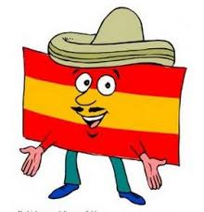
Modern Languages
You can choose to study one or two of the following subjects:
French
Spanish
Modern Languages for Life and Work.
In addition to the above you can also choose German (elective column)

Slide 14
French
Express yourself across a wide range of topics and learn to communicate properly with European and worldwide neighbours
Study in a fun but effective learning environment through music, role play and games.
Learn about how people in French speaking countries live their lives.
Improve your employability skills by being able to read and understand a different language and show off about this to college, university or employers!

Slide 15
Spanish
Be a part of one of the biggest language communities in the world.
Keep up with popular Latino culture.
Improve your chances of getting a well paid job.
Be a global citizen - enhance your travel experiences and communicate with the locals on holiday.

Slide 16
German
Learn to communicate in the most wanted European language by UK companies.
German companies are global market leaders.
Make good use of your Scottish accent to sound
A science or engineer fan? German is the second most commonly used language in science and engineering.

Slide 17
Modern Languages for Life and Work
Build partnerships with local businesses.
Improve employability
skills for a college place, apprenticeship or a job.
You will learn about relevant topics which will help you
gain confidence in a
different language
If this is the best option for you, your Modern Languages Teacher will talk to you about it.

Slide 18
Science
You are choosing (at least) one of the following subjects:
- Biology
- Chemistry
- Physics

Slide 19
Biology
You will get to study a huge range of topics including:
evolution
food production
health technologies
enzymes
the human body
cells
biotechnology
the brain
genetic engineering
photosynthesis

Slide 20
Chemistry
You will get the opportunity to find out:
Atomic structure
Chemistry’s role in:
Medicine
Energy
Industry
Environmental issues
Chemical reactions
The periodic table
Chemical bonding

Slide 21
Physics
You will be involved in a variety of activities which show you how Physics applies to real life.
Electricity
Space
Energy
Satellites
Nuclear power
Cosmology
Light
Speed & acceleration
Sound

Slide 22
Humanities (Social Subjects)
You are choosing (at least) one of the following subjects:
Accounting
Business Management
Geography
History
Modern Studies
People and Society

Slide 23
Accounting
This course is suitable for you if you:
Enjoy working with numbers
Are interested in the financial success of businesses – maybe even your own in years to come!
Want to be your own boss and manage your own business finances
This course will be suitable for all learners who are interested in a career in:
Business
Financial Management
Banking
Insurance
Accountancy
The following link will give you an idea of some of the jobs people with
an accounting background might do:
https://www.myworldofwork.co.uk/search/sitewide/Accounting?page=1&group=job_profile

Slide 24
Business Management
You will learn about the importance of business in society.
Studying Business Management will allow you to transfer skills between the classroom and the work place and it will raise your awareness about the importance of entrepreneurial and business skills in society.
Throughout the course you will be working on tasks that help to develop and enhance business skills in:
Analysis
Decision making
Enquiring
ICT
Problem solving
Research (internet based, paper based)

Slide 25
Geography
Geography is the study of Earth's landscapes, peoples, places and environments. It is, quite simply, about the world in which we live.
In S3 Geography we study physical, human and global issue topics.
Courses are built upon pupil personalisation and choice to give us wide access to a number of topics.
Natural environments
How and where people live in the world
Current Geographical issues impacting around the world – like Health and Migration
We will complete an added value unit which is a project based on knowledge we have covered in our topics.
We will continue to build and develop on our Ordnance survey mapping skills.

Slide 26
History
You will learn how past events and people have shaped the society that we live in today.
In S3 History you will study the Holocaust and then move on to learning about the Atlantic Slave Trade 1770-1807. This will help you understand British History and how it is intertwined with the history of other peoples around the world.

Slide 27
Modern Studies
In Modern Studies we will study the world we live in today from a social, political and economic perspective.
In S3 we will study big issues in the UK today. These include Democratic Rights, the Media and Social Inequality.
We will look at the crisis in Israel/Palestine.
We will then start examining Crime and The Law.

Slide 28
People and Society
People and Society
People and Society is a combination of different themes within Social Subjects.
Next year, the topics will include The Sixties (History) and the USA (Modern Studies).
This subject leads on to the National 4 People and Society course in S4. After S4, you may decide to focus on a specific Social Subject.
This option is for specific pupils only – your Pastoral Care Teacher or Social Subjects Teacher will speak to you if it applies to you.

Slide 29
Technologies
You are choosing (at least) one of the following subjects:
Administration
Computing Science
Design and Manufacture
Graphic Communication
Practical Woodworking
Music Technology

Slide 30
Administration
Administration will build upon strengths developed in S2.
You will develop skills in word processing, spread sheets, databases and desktop publishing software.

Slide 31
Computing Science
This course aims to develop computational thinking and problem solving skills which are essential for all pupils entering the workplace. Throughout the course pupils will be working on tasks that help to develop an understanding about the relationship between hardware and software and the technological trends that drive the marketplace.
Pupils will explore computer security, interactive multimedia solutions, computer systems and emerging technologies, basic principles of programming, and creating graphics and animations.

Slide 32
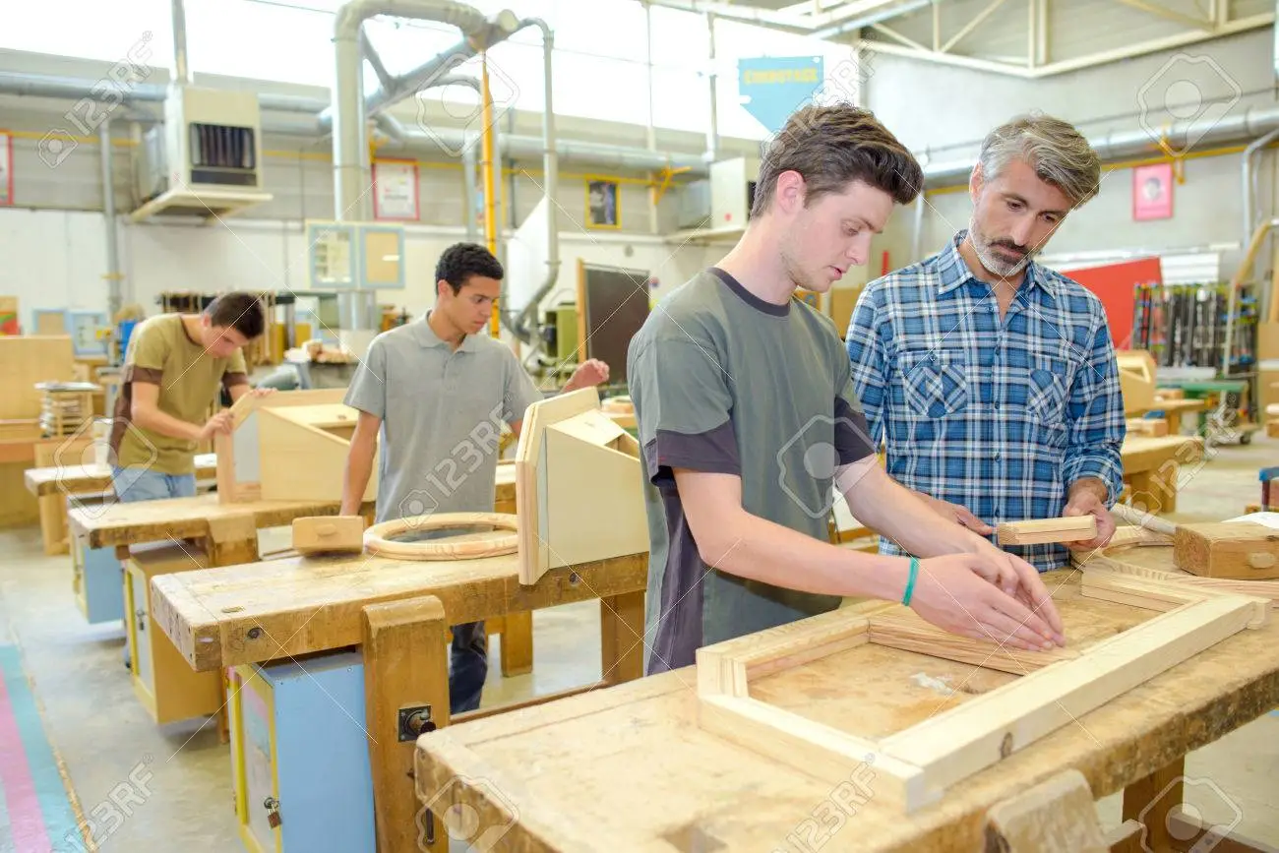
Design and Manufacture
Learners will develop their design skills and knowledge and understanding of materials and manufacturing processes, and enhance their creative and practical skills.
Design and manufacture allows you build your skills in designing and developing your ideas, eventually progressing onto making them in the senior school.
Learners will gain knowledge into how design and manufacture relates to their everyday lives and can be valuable for further learning.
Design and manufacture allows you
to study from national 4 all the way
to advanced higher.
D&M requires you to be in the classroom and the workshop. You create designs and make practical models.

Slide 33
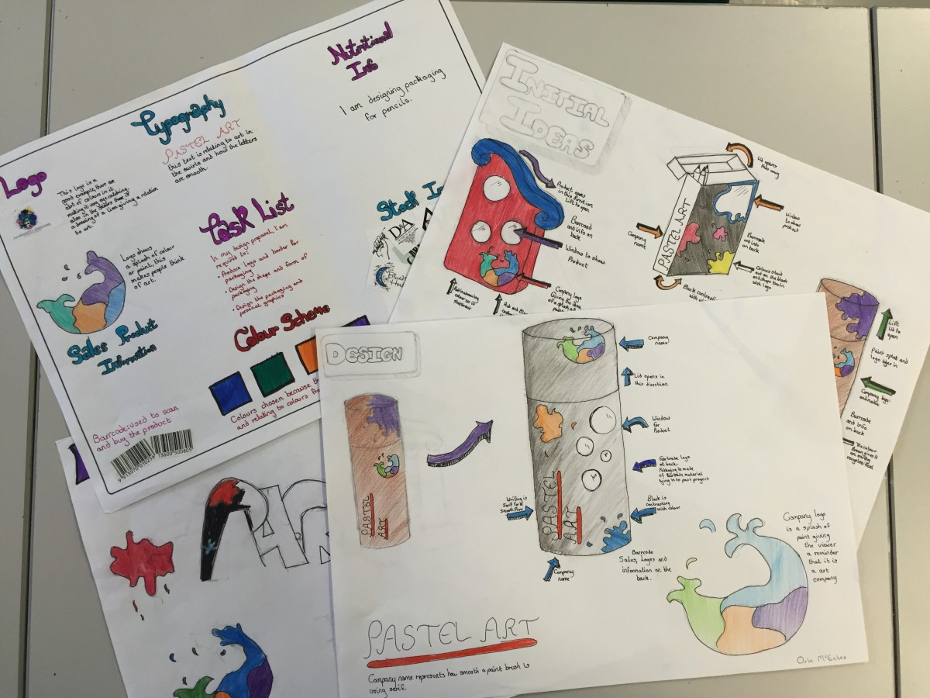
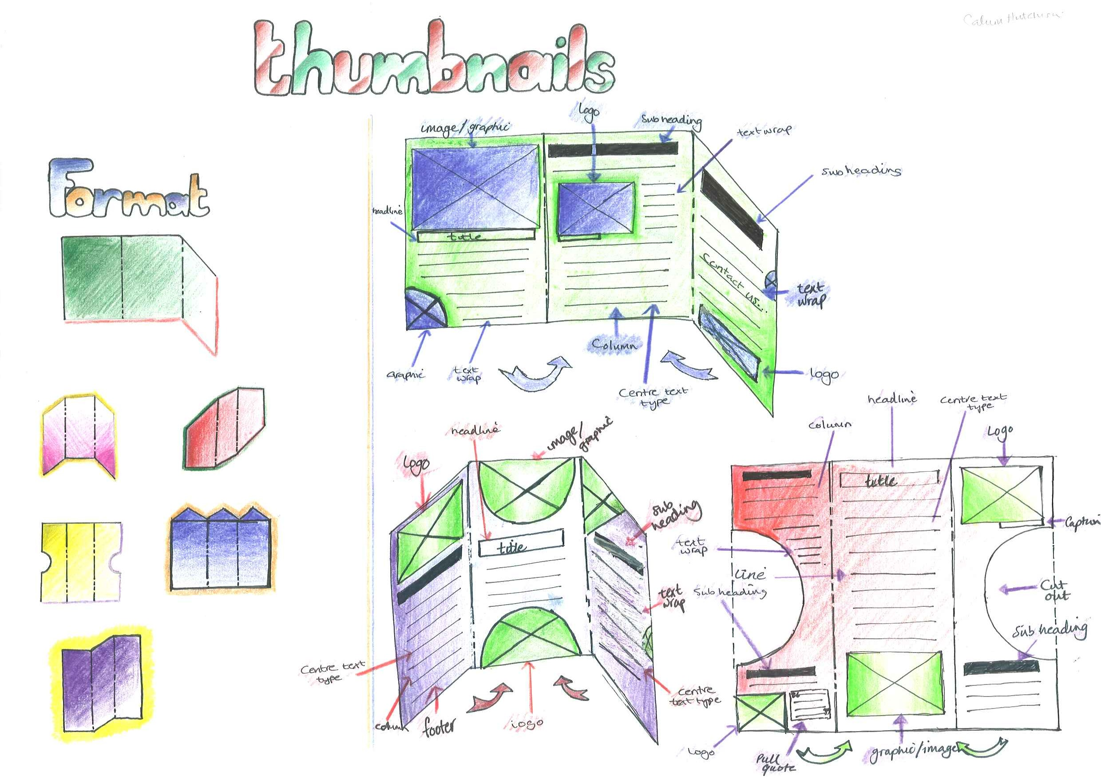
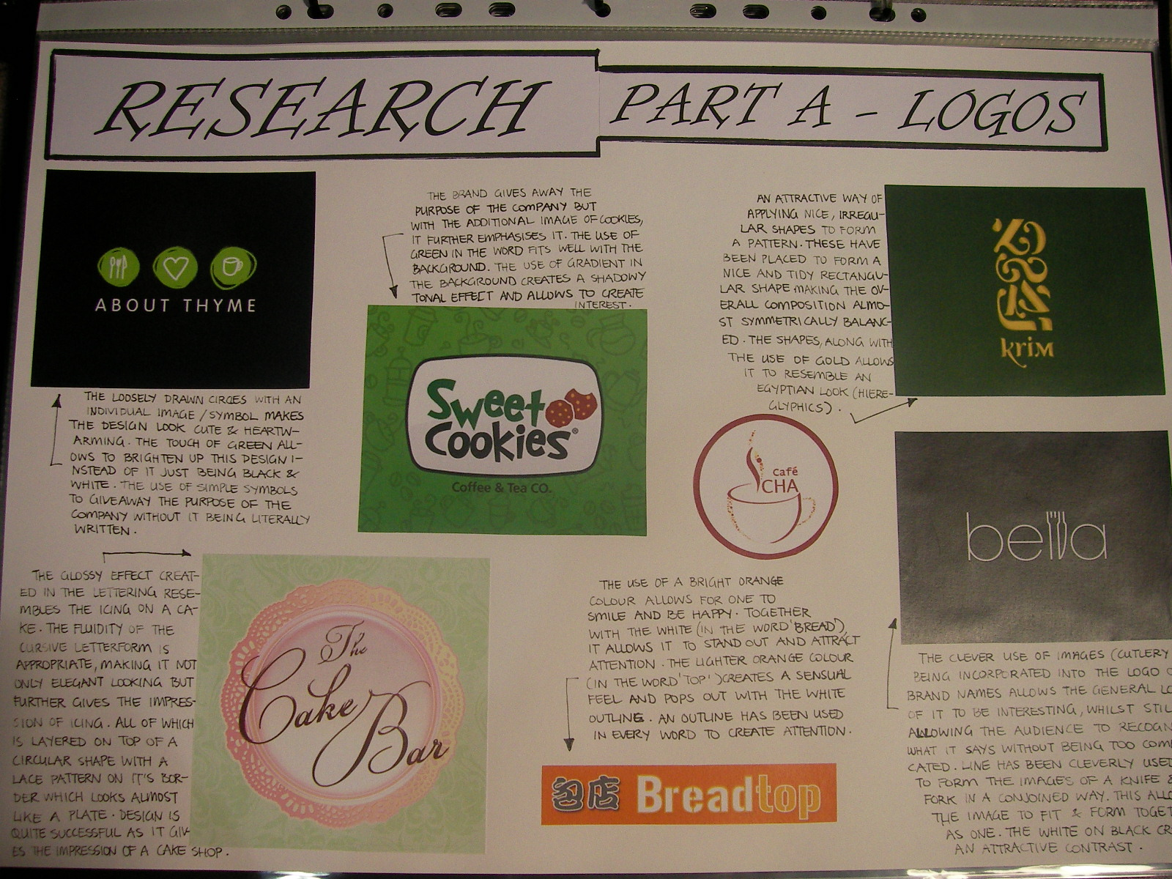
Graphic Communication
The S3 Graphic Communication course combines elements of creativity and communicating for visual impact. It allows learners to engage with a range of technological applications.
Learners are encouraged to exercise their imagination, creativity and logical thinking. They will develop an awareness of graphic communication and understand how it can be invaluable for life-long learning and for the world of work.
This course enables learners to develop an understanding of how graphic communication technologies impacts our society. Develop skills in graphic communication techniques, including the use of equipment, graphics materials
and software.
GC is a class based subject – you won’t be in the workshop

Slide 34
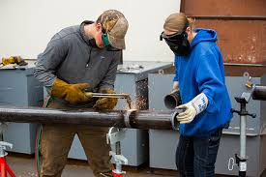
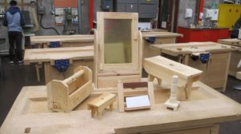
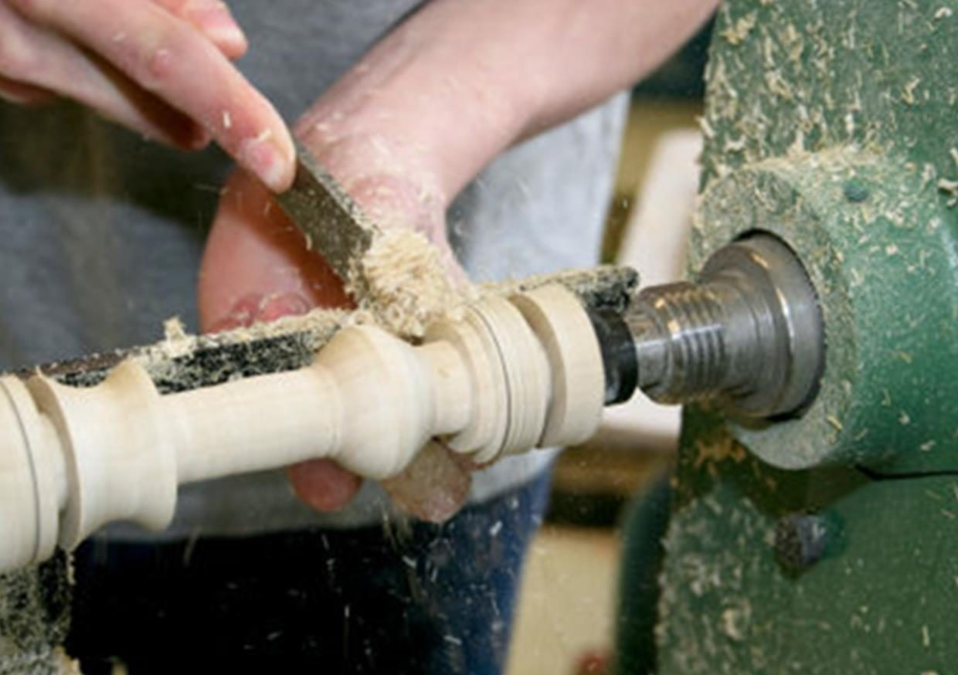
Practical Woodworking
The S3 Practical Woodworking course provides opportunities for learners to gain skills in reading drawings/diagrams in the completion of finished wood –based products.
The course is highly practical and creative in nature, improving learner’s skills, whilst operating a variety of tools, equipment and materials. It also helps learners develop practical numeracy skills.
This course enables learners to develop a range of skills, from measuring and marking out timber, to their
practical creativity skills to
understanding all about sustainable materials,
PWW is predominately a workshop based course

Slide 35
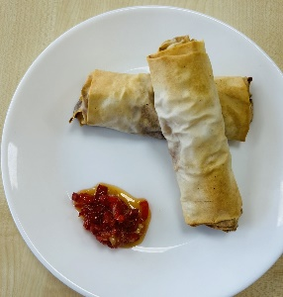
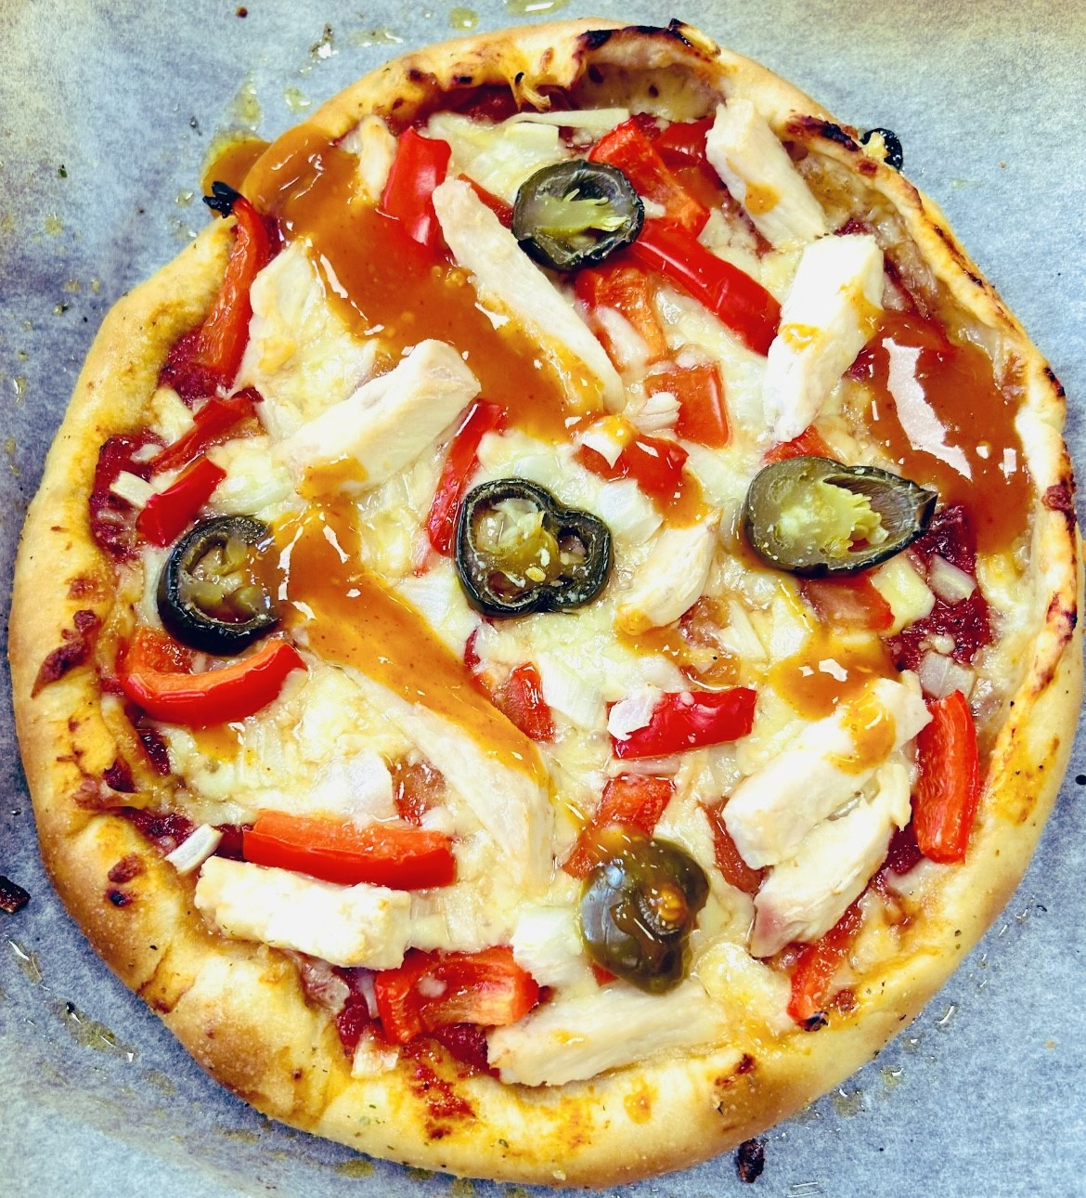
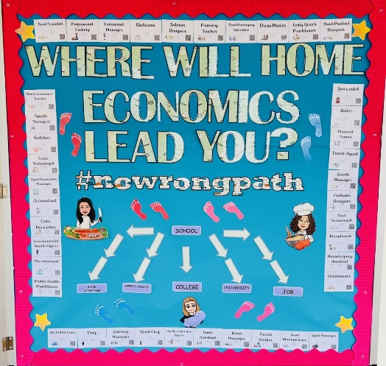
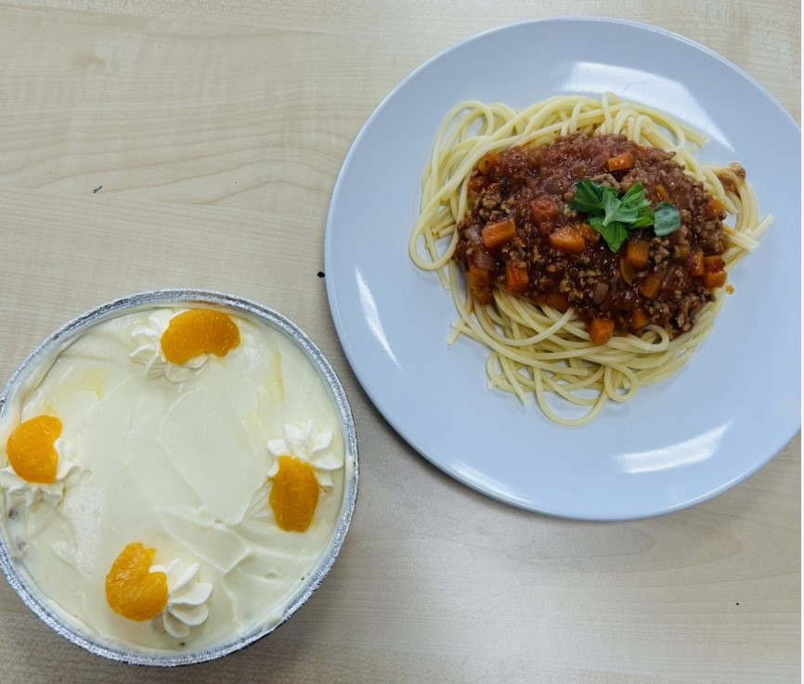
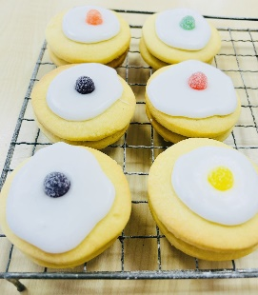
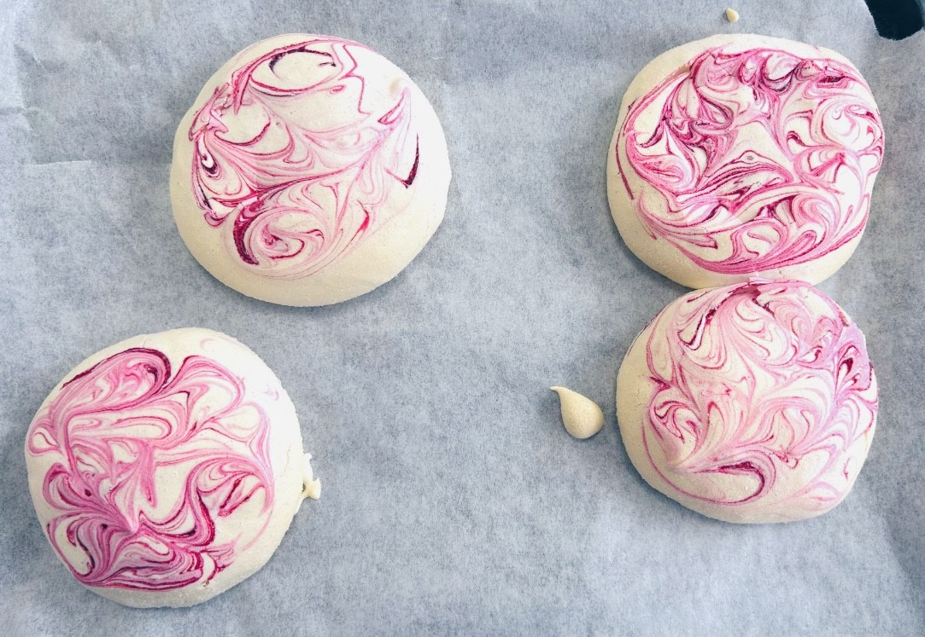
Home Economics
Check our Twitter for more amazing dishes you could be making: @KpssPEandHE
What You Will Learn
In S3 Home Economics you will get the opportunity to ‘taste’ each of our Senior Phase courses; Practical Cookery, Health & Food Technology and Childcare. We will cover elements from all 3 courses including cooking double dishes, developing a new food product and looking after and providing for the child. This is an extremely creative and diverse subject with aspects of both theory and practical, including a double period of cooking each week.
Why Choose It?
This subject allows you to cook a variety of and vibrant, exciting and complex dishes. You will also have opportunity to design your very own food product, testing your creativity and inner ‘Gordon Ramsay’ skills. Home Economics opens doors to a huge world of exciting careers, be sure to check out our ‘no wrong path’ board to find out more!

Slide 36
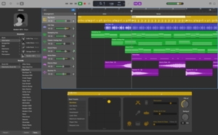
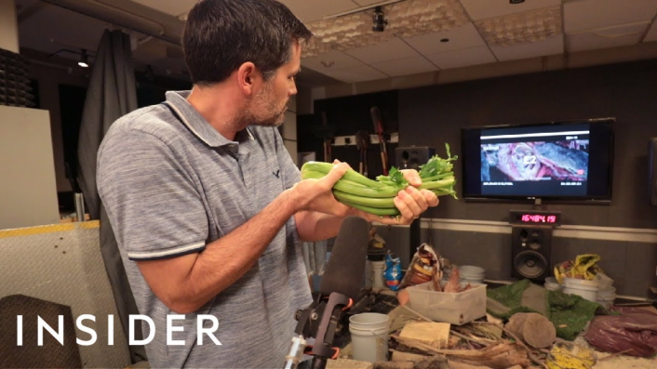
Music Technology
Learn about different genres of Popular music (Pop, Rock, Hip-Hop, Rap etc.)
Use GarageBand to complete projects such as –
Radio Shows
Audiobooks
Foley
Adding sound to film clips and computer games
Learn how to mix and edit music
Work individually and as a group

Slide 37
Free Choice Column
In this column you can pick any of the subjects that appear in any other column. Please make sure you select your 1st, 2nd and 3rd choice.
Do not select a subject you have already chosen as a first option - no matter how much you like it!
You can only select German and Design and Manufacture in this column.

Slide 38
Frequently asked questions
Can I study a subject in S4 if I haven’t chosen it in S3?
It is always best to continue with subjects you experienced in S3 as you will have a greater depth of knowledge. You may be able to select a new subject in S4 and this would be looked at on an individual basis.
Can I change my subject choice during S3?
Only under exceptional circumstances with the agreement of your Pupil Support Teacher and Parent/Carer.
Will I get all the choices I have made?
The school will try its best to meet everybody's choices but your first choice cannot be guaranteed.
What kind of work will I be doing in my chosen subjects?
You will have the chance to develop skills and understanding which will help you when you start your National Qualifications in S4.

Slide 39
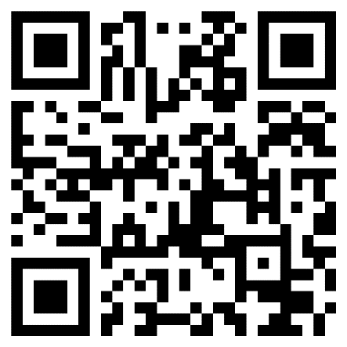
What next?
You will be given a Personalisation and Choice information sheet via Satchel: One. Please discuss the options with your parent / carer.
If you or your parent/carer has any questions, you should contact your Pastoral Care Teacher.
The Personalisation and Choice form will be completed using a Google Form. You can access this from your Glow account using the link or QR code on the information sheet or the QR code at the top right of this screen.
Forms should be submitted by Friday 19th January 2024

