Slide 1
S2 Personalisation and Choice
January 2021

Slide 2
S2 Personalisation and Choice
Next year you will have the opportunity to personalise your curriculum in certain areas.
In S3, all pupils will continue studies in the following subjects:
English
Maths
Health and Wellbeing
PE
Food Technology
RME
PSE

Slide 3
S2 Personalisation and Choice
In addition to this you will choose:
1 Expressive Arts subject;
1 Modern Language;
1 Science subjects;
1 Humanities subjects (Social Subjects);
1 Technology subject;
1 subject from the elective column.

Slide 4
Let’s have a closer look at each choice you need to make

Slide 5
Expressive Arts
You are choosing (at least) one of the following subjects:
Art and Design
Drama
Music

Slide 6
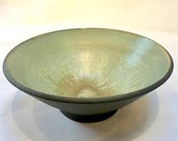
Art and Design
Research, design, create and review – ceramic fruit bowl
Product
Design
Unit
Expressive
Unit
Research paintings, then design and create a still life image
Notes:
All pupils follow a product design unit observing examples of excellent products in society. All pupils then begin work on a research and development project on ceramic fruit bowl design. They will look at a variety of themes and established products and develop a personal design from their initial selection.
All pupils will create a ceramic bowl in S3 using a clay coil method. This will be glazed and fired and will be available for the pupils to take home.
All pupils will critically review a variety of product design and will research the work of selected designers.
Expressive
All pupils follow an expressive unit observing examples of excellent paintings in society. All pupils then begin work on a research and development project on a still life image. They will look at a variety of themes and established paintings and develop a personal theme from their initial selection.
All pupils will create an A2 or A3 expressive painting / chalk pastel / oil pastel outcome.
All pupils will critically review a variety of paintings and will research the work of selected expressive artists

Slide 7
Drama
Devising Drama
Peer Assessment
Practical Work
Teamwork
Make up & Costumes
Drama Terminology
Film and sound editing
Performing opportunities
Lighting and sound

Slide 8
Music
Learn about different genres of music (e.g. Popular, Classical and Scottish)
Choose two instruments:
Voice
Tuned Percussion Keyboard
Guitar
Bass Guitar
Drum kit
Orchestral
Learn how to read music
Create/ Compose your own pieces
Perform your pieces to the class
Tests - Practical and written

Slide 9
Modern Languages
You are choosing (at least) one of the following subjects:
French
Spanish
German
Modern Languages for Life and Work
“The limits of my language mean the limits of my world”

Slide 10
French
Learn to communicate with European neighbours.
Culture- Learn about how citizens in French speaking countries live
Learn with music, role play and games
Stand out from the crowd- learn the language from Scotland’s oldest ally

Slide 11
Spanish
Be a part of one of the biggest language communities in the world.
Keep up with popular Latino culture.
Improve your chances of getting a well paid job.
Be a global citizen - enhance your travel experiences and communicate with the locals on holiday.

Slide 12
German
Learn to communicate in the most wanted European language by UK companies.
German companies are global market leaders.
Make good use of your Scottish accent to sound
A science or engineer fan? German is the second most commonly used language in science and engineering.

Slide 13
Modern Languages for Life and Work
Build partnerships with local businesses.
Improve employability
skills for a college place, apprenticeship or a job.
You will learn about relevant topics which will help you
gain confidence in a
different language
If this is the best option for you, your Modern Languages Teacher will talk to you about it.

Slide 14
Science
You are choosing (at least) one of the following subjects:
- Biology
- Chemistry
- Physics
- Science

Slide 15
Biology
You will get to study a huge range of topics including:
evolution
food production
health technologies
enzymes
the human body
cells
biotechnology
the brain
genetic engineering
photosynthesis

Slide 16
Chemistry
You will get the opportunity to find out:
Atomic structure
Chemistry’s role in:
Medicine
Energy
Industry
Environmental issues
Chemical reactions
The periodic table
Chemical bonding

Slide 17
Physics
You will be involved in a variety of activities which show you how Physics applies to real life.
Electricity
Space
Energy
Satellites
Nuclear power
Cosmology
Light
Speed & acceleration
Sound

Slide 18
Science
This option is only for specific pupils only – your Pastoral Care Teacher or Science Teacher will speak to you if it applies to you.
This course will focus largely on developing problem solving skills and practical and team working skills.

Slide 19
Humanities (Social Subjects)
You are choosing (at least) one of the following subjects:
Business Management
Geography
History
Modern Studies
People and Society

Slide 20
Business Management
You will learn about the importance of business in society.
Studying Business Management will allow you to transfer skills between the classroom and the work place and it will raise your awareness about the importance of entrepreneurial and business skills in society.
Throughout the course you will be working on tasks that help to develop and enhance business skills in:
Analysis
Decision making
Enquiring
ICT
Problem solving
Research (internet based, paper based)

Slide 21
Geography
Geography is the study of Earth's landscapes, peoples, places and environments. It is, quite simply, about the world in which we live.
In S3 Geography we study physical, human and global issue topics. This will focus on our natural environments, how and where people live and current geographical issues impacting around the world.Our courses are built upon pupil personalisation and choice to give us wide access to a number of topics.
We will complete an added value unit which is a project based on knowledge we have covered in our topics.
We will continue to build and develop on our Ordnance survey mapping skills.

Slide 22
History
You will learn how past events and people have shaped the society that we live in today.
In S3 History you will study the Civil Rights Movement in the USA and then move on to learning about the Atlantic Slave Trade 1770-1807. This will help you understand British History and how it is intertwined with the history of other peoples around the world.

Slide 23
Modern Studies
In Modern Studies we will study the world we live in today from a social, political and economic perspective.
In S3 we will study a world power and international issues.
The world power you will focus on is the USA where we explore the political system, social issues and influence within the USA.
We also cover a Black Lives Matter unit where we look at the experiences of African Americans in the USA.
Lastly, we explore conflict within the Middle East and analyse the relationship between this region and the USA.

Slide 24
People and Society
People and Society
People and Society is a combination of different themes within Social Subjects.
Next year, the topics will include The Sixties (History) and the USA (Modern Studies).
This subject leads on to the National 4 People and Society course in S4. After S4, you may decide to focus on a specific Social Subject.

Slide 25
Technologies
You are choosing (at least) one of the following subjects:
Administration
Computing
Graphic Communication
Music Technology
Practical Woodwork

Slide 26
Administration
Administration will build upon strengths developed in S2.
You will develop skills in word processing, spread sheets, databases and desktop publishing software.

Slide 27
Computing Science
This course aims to develop computational thinking and problem solving skills which are essential for all pupils entering the workplace. Throughout the course pupils will be working on tasks that help to develop an understanding about the relationship between hardware and software and the technological trends that drive the marketplace.
Pupils will explore computer security, interactive multimedia solutions, computer systems and emerging technologies, basic principles of programming, and creating graphics and animations.

Slide 28
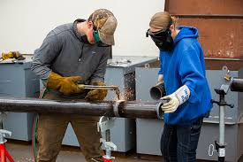
Graphic Communication
The S3 Graphic Communication course combines elements of creativity and communicating for visual impact. It allows learners to engage with a range of technological applications. Learners are encouraged to exercise their imagination, creativity and logical thinking. They will develop an awareness of graphic communication and understand how it can be invaluable for life-long learning and for the world of work.
The course aims to enable learners to:
Develop skills in graphic communication techniques, including the use of equipment, graphics materials and software.
Extend and apply knowledge and understanding of graphic communication standards and protocols, and understand where and how these should be applied.
Develop an understanding of the impact of graphic communication technologies on our environment and society.

Slide 29
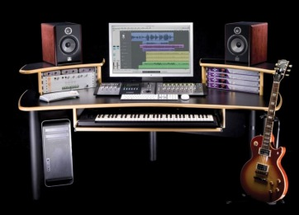
Music Technology
Learn about different genres of Popular music (Pop, Rock, EDM, Rap etc.)
Use GarageBand to complete short projects such as
Radio Broadcasts
Audiobook
Foley (Adding
sound to film clips/computer games)
Learn how to record a ‘band’ performance (DK, Keys, Guitars, Vocals)
Tests - Practical and written
Self and Peer assessment

Slide 30
Practical Woodwork
The S3 Practical Woodworking course provides opportunities for learners to gain skills in reading drawings/diagrams in the completion of finished wood –based products. The course is highly practical and creative in nature, improving learner’s skills, whilst operating a variety of tools, equipment and materials. It also helps learners develop practical numeracy skills.
The course aims to enable learners to:
Develop skills in woodworking techniques.
Measure and mark out timber sections and sheet materials.
Undertake safe working practices in workshop environments.
Demonstrate practical creativity and problem solving skills.
Understand materials sustainability.

Slide 31
Free Choice Column
In this column you can pick any of the subjects that appear in any other column. Please make sure you select your 1st, 2nd and 3rd choice.
Do not select a subject you have already chosen as a first option - no matter how much you like it!
You can also select German in this column.

Slide 32
Frequently asked questions
Can I study a subject in S4 if I haven’t chosen it in S3?
You will be able to select a subject in S4 if you did not take it in S3, however it is best to continue with subjects you experienced in S3 as you will have a greater depth of knowledge.
Can I change my subject choice during S3?
Only under exceptional circumstances with the agreement of your Pupil Support Teacher and Parent/Carer.
Will I get all the choices I have made?
The school will try its best to meet everybody's choices but your first choice cannot be guaranteed.
What kind of work will I be doing in my chosen subjects?
You will have the chance to develop skills and understanding which will help you when you start your National Qualifications in S4. Remember you will make choices again at the end of S3.

Slide 33
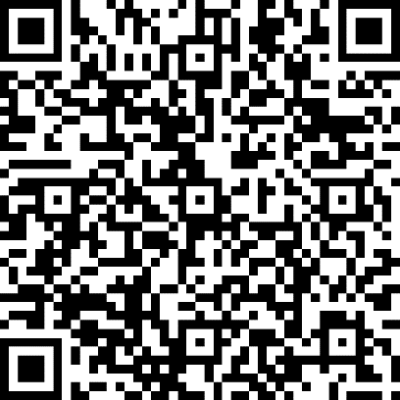
What next?
You will be sent your Personalisation and Choice information sheet via Satchel: One. Please discuss the options with your parent / carer.
If you or your parent/carer has any questions, you should contact your Pastoral Care Teacher via e-mail.
The Personalisation and Choice form will be completed using a Google Form. You can access this from your Glow account using the link or QR code on the information sheet or the QR code at the top right of this screen.
Forms should be completed by Friday 25th January 2021.

