Slide 1
Assessment Block
Information for Learners
December 6th – 16th
Notes:
1

Slide 2
Assessment Block
The assessment block has been planned to assess your progress within your learning so far.
All learners should only have a maximum of 2 assessments per day.
All learners should experience an assessment within the set up of the Assembly Hall.
Disruption has been minimalised as much as possible to ensure you can continue to learn within class during the assessment period.
Assessments will run from Monday 6th December – Thursday 16th December inclusive.
Notes:
MyExam app
Create a personal timetable, view your exam schedule, add notes and add to other calendars
MyStudyPlan app
Organise your revision by creating your own study plan
Activity: if tech, download apps or look at online version of timetable builder.

Slide 3
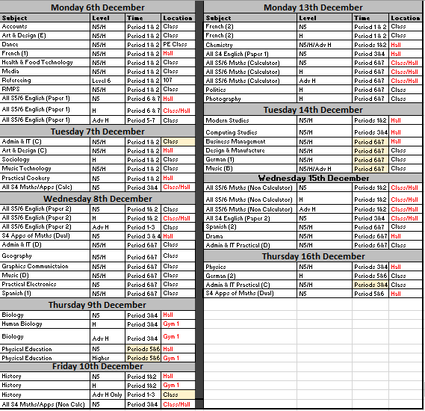
Timetable
Note changes in yellow including Ad H History location, PE time and Admin time/location ☺
Notes:
MyExam app
Create a personal timetable, view your exam schedule, add notes and add to other calendars
MyStudyPlan app
Organise your revision by creating your own study plan
Activity: if tech, download apps or look at online version of timetable builder.

Slide 4
Points to note:
There is no study leave during this window of time and full attendance is expected throughout the assessment calendar.
Locations are either in your normal class, assembly hall or small gym (gym 1). This is unless otherwise noted.
It is important you check with your class teacher regarding individual assessments to ensure you are aware of date, time and location.
The letter beside some subjects is the column for that specific class (check this with your class teacher)
Notes:
MyExam app
Create a personal timetable, view your exam schedule, add notes and add to other calendars
MyStudyPlan app
Organise your revision by creating your own study plan
Activity: if tech, download apps or look at online version of timetable builder.

Slide 5
Our expectations:
Before any assessment, all bags, jackets and valuables must be left in the designated area. All phones must be turned off at this point.
Everyone must arrive at their assessment on time. Any late coming will bring a penalty to your performance as you will have less time to complete the assessment.
Nobody will be able to leave assessments before the end of the time specified.
Everyone must treat assessments, learners and invigilators with respect at all times.
Notes:
MyExam app
Create a personal timetable, view your exam schedule, add notes and add to other calendars
MyStudyPlan app
Organise your revision by creating your own study plan
Activity: if tech, download apps or look at online version of timetable builder.

Slide 6
Malpractice:
Malpractice means any act that is a breach of SQA requirements.
This may include an act that compromises or attempts to compromise, the process of assessment.
Examples might include: —
completing assessment work on behalf of learners.
falsification of information from another learner.
breaching the security of assessment materials in a way which threatens the integrity of any exam or assessment, including sharing questions.
prohibited items — possessing items that candidates must not have with them at their allocated seat in the examination e.g. notes or a mobile.
Conduct during or after an assessment.
All malpractice will be fully investigated and may result in: a written warning, a revision of marks and/or a disqualification from future assessments.
Notes:
MyExam app
Create a personal timetable, view your exam schedule, add notes and add to other calendars
MyStudyPlan app
Organise your revision by creating your own study plan
Activity: if tech, download apps or look at online version of timetable builder.

Slide 7
Studying and planning
It is so important that you plan your time effectively during the assessment block. Focus on the following:
Having a study plan
Supported Study
Quiet Study Sessions
Mentor Sessions and target setting
My SQA study tips
Having access to all class materials
E-Sgoil live study webinars - https://www.e-sgoil.com/study-support/
Notes:
MyExam app
Create a personal timetable, view your exam schedule, add notes and add to other calendars
MyStudyPlan app
Organise your revision by creating your own study plan
Activity: if tech, download apps or look at online version of timetable builder.

Slide 8
Find past papers
www.sqa.org.uk/pastpapers
Notes:
Activity: find a past paper for your best/favourite subject. Questions arising.

Slide 9
Additional Arrangements
All arrangements must be confirmed through Ms Bertolini.
You will be asked to sign a confirmation of arrangement, time and location.
If this has not happened, you must speak with your house PTPC or Ms Bertolini herself to confirm arrangements in place. This ensures it is fair for everyone.

Slide 10
Most of all..!

